Slide 1

Jedi Bootcamp
JEDI- Group 5

Slide 2
Where We Started ...
Freshers eager to get practical knowledge
Notes:
Limited knowledge of development of full fledged projects Lack of experience in working on end to end project follow
Pre Learning materials for clearing basic concepts

Slide 3

Framework for the Bootcamp
Very well planned 12 day Bootcamp covering end to end flow of Backend Development
Daily progress check-in and valuable reviews on UML diagrams, Code and Database Integration
Engaging Demonstrations for all topics with very active doubt clearing sessions
Challenging Assignments regularly for better grasp on the concepts
Every topic concluded with a multiple choice assessment with the right level of difficulty
Problem statement followed throughout the journey as scope of project covering the software development cycle
Demo of the final project created
Steep Learning Curve from basic git commands to Integration of REST services with Java code using Tomcat and Jersey

Slide 4

12 Days
96 Hours
5760 Minutes
345600 Seconds
Limitless Knowledge

Slide 5

Stakeholders
Sponsor : Flipkart
SME : Amit Balyan
Other Coordinators : Khusboo Agrawal Zain Inhonvi Deepika Gajaraj

Slide 6
Agenda for the Presentation
1. Our Team
2. Our Journey
3.Project
Goals
4. Engineering P Practices
5. Tech Stack
6. Challenges And Learnings
7. Demo
8.Questions
Notes:
Deepali

Slide 7
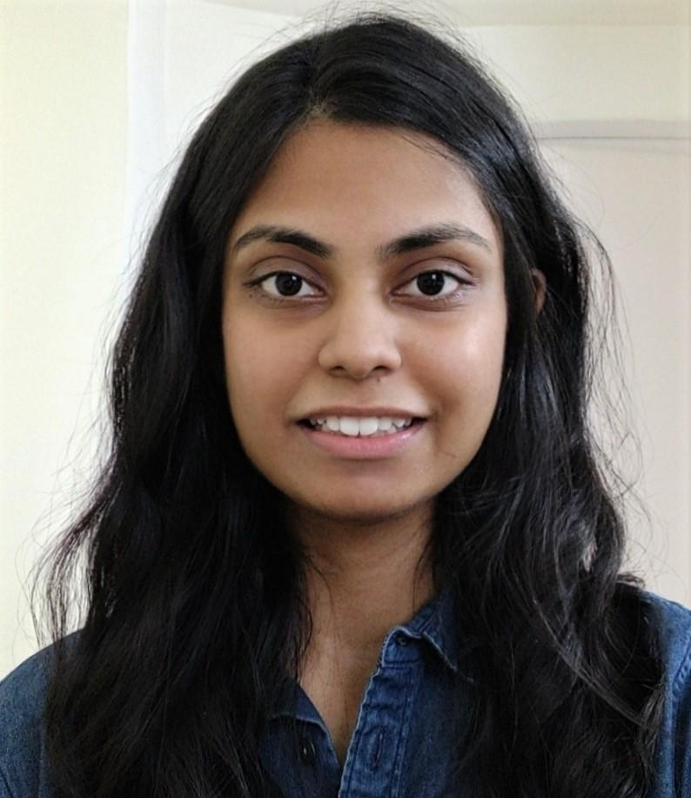
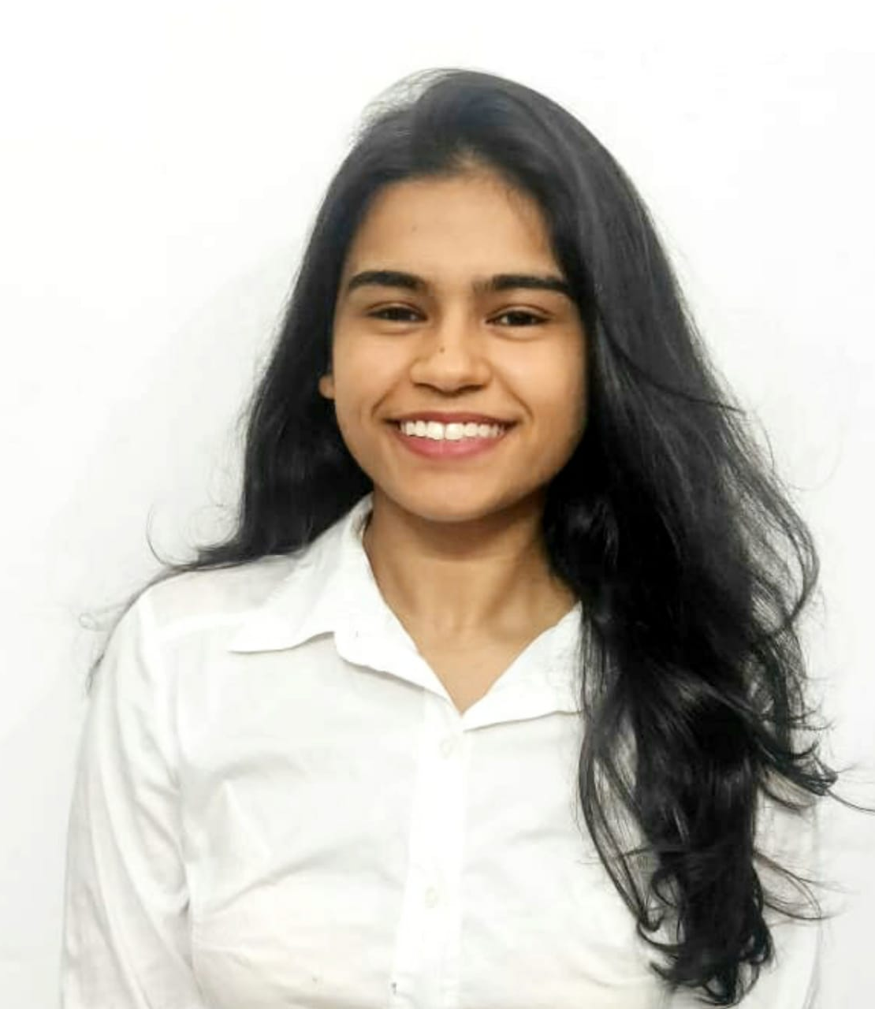
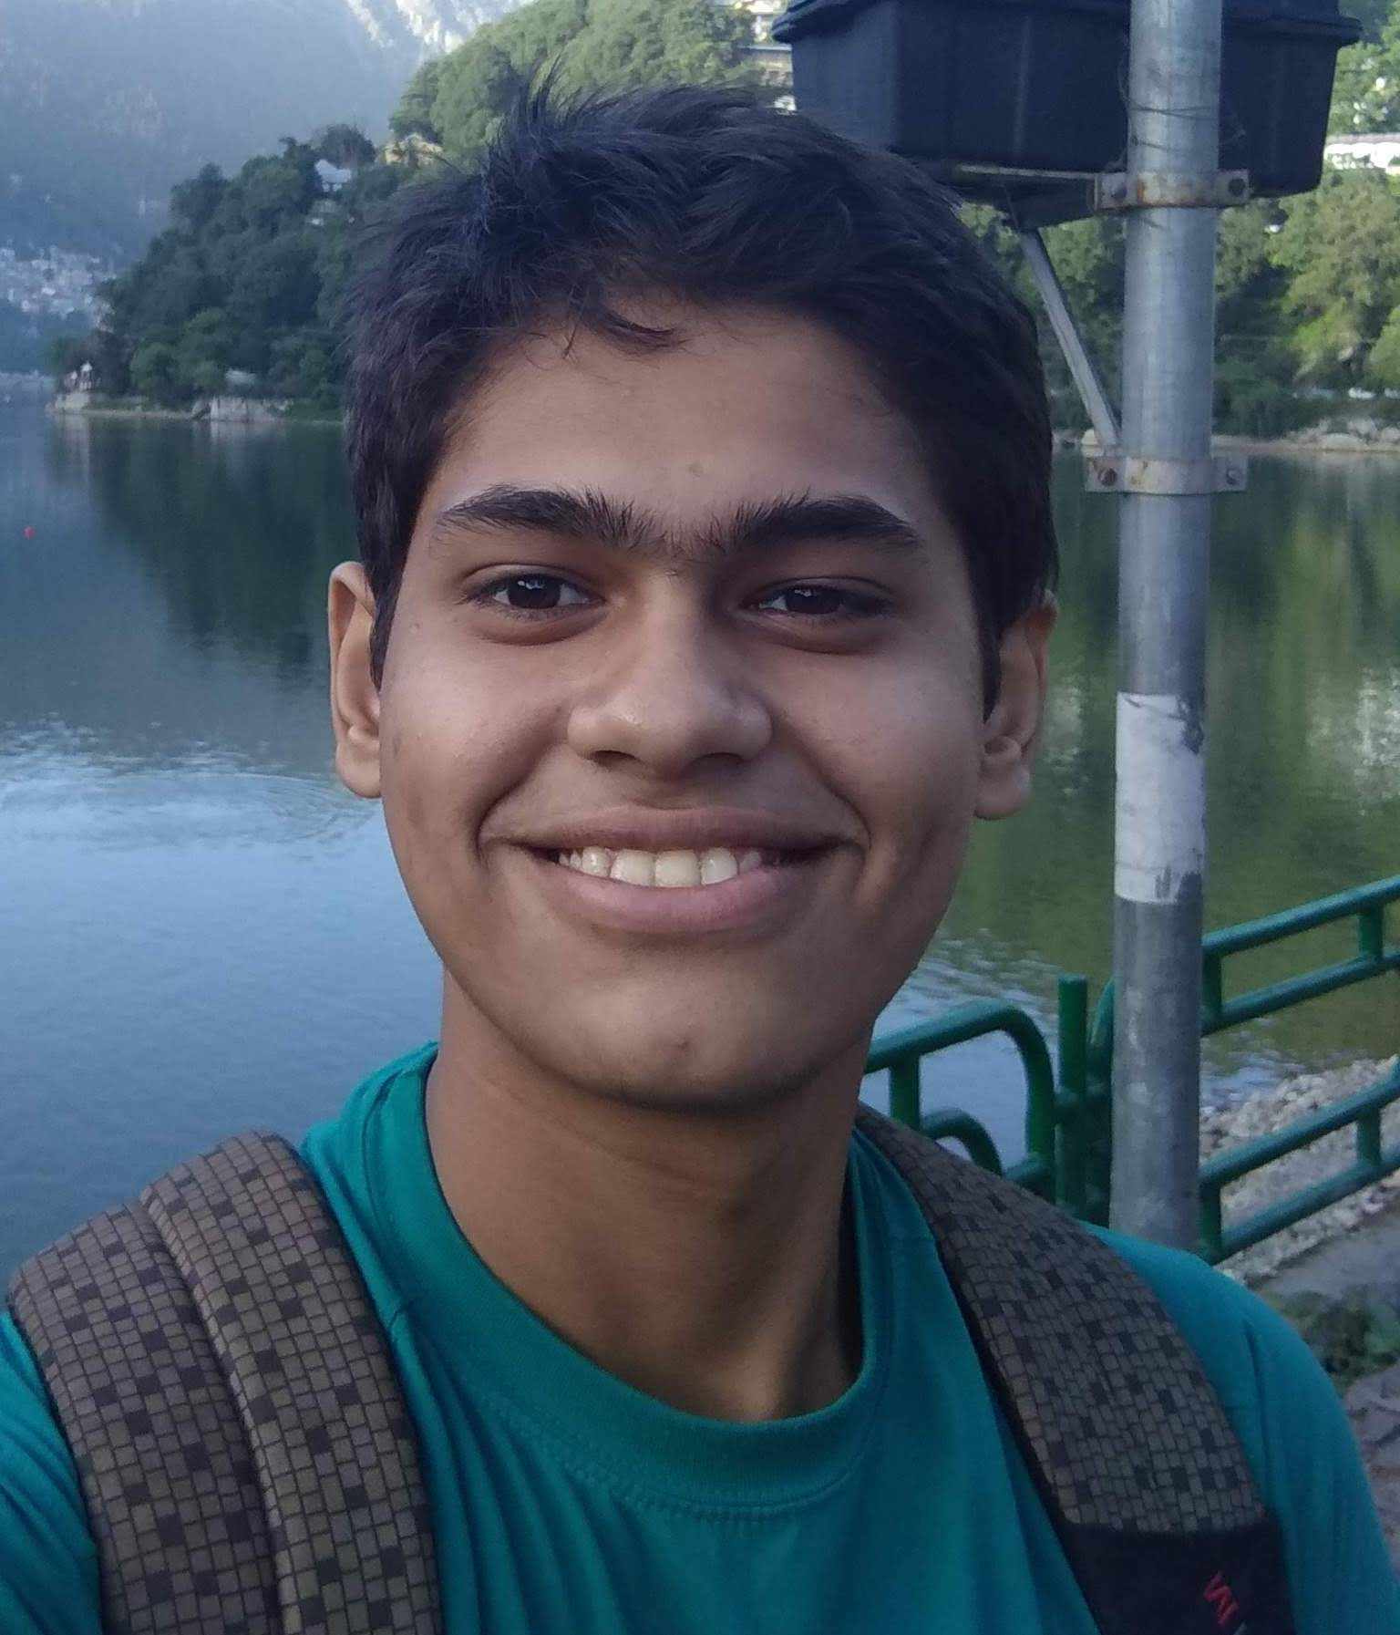
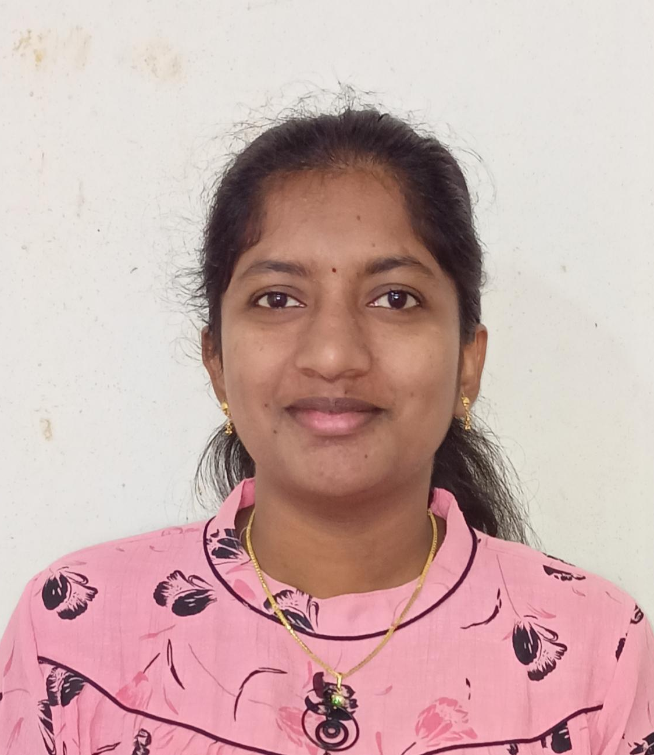
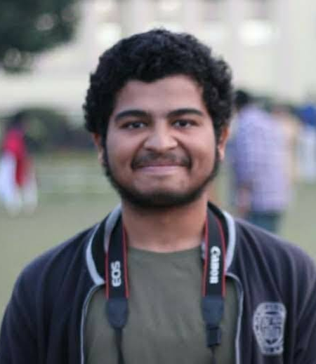
Team Members
Deepali Sharma
( Team Leader/Manager)
Charu Tandon
(Designer)
Ishaan Rawat (Multitasker)
Pravallika Boppana (Top Fragger)
Nachiket Agni (Sharp-eyed)

Slide 8
Our Journey
COMPREHEND:
Understanding Project Goals and learning basics
PROCESS: Design Thinking
And UML modelling
PROCESS: Project Demonstration
1
3
5
2
4
MINDSET: Adopting a Developer Mindset , Learning technologies and implementation
TOOLS: Learning the Technologies Java/REST
Notes:
Major milestones

Slide 9
Track of the JEDI Bootcamp
Pre reads provided before the training
Introduction to Linux and Ubuntu
Introduction to Git and Github
Software Development Life Cycle, Object-oriented analysis and design and UML modelling
Core Java Programming concepts for implementing the project
MySQL Fundamentals for database queries and collaborating with JDBC
REST web services to build the client functionalities that connects with other systems
DropWizard as tool to deploy REST Web Services
Project Presentation and Documentation Work

Slide 10

Project Goals
To develop a Course Registration System using Java Development Tools , MYSQL
Primary actors of the Project include
Student : register for courses, get graded, view their grade card, make payment
Professors : select courses to teach and grade the students enrolled in their courses
Admins : manage users, courses and approve students for course registration
They can perform operations and further deployment using REST and Dropwizard.
Notes:
Charu

Slide 11
Engineering Practices
Modelling
Scope
Project Planning
Project
Grooming
Requirement Understanding
Research and Analysis
Estimation
Delivery
Project
Implementation
Integrate
Deploy
Test
Development
Code Review
Commit

Slide 12

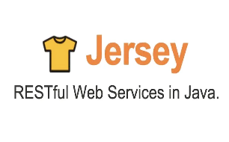

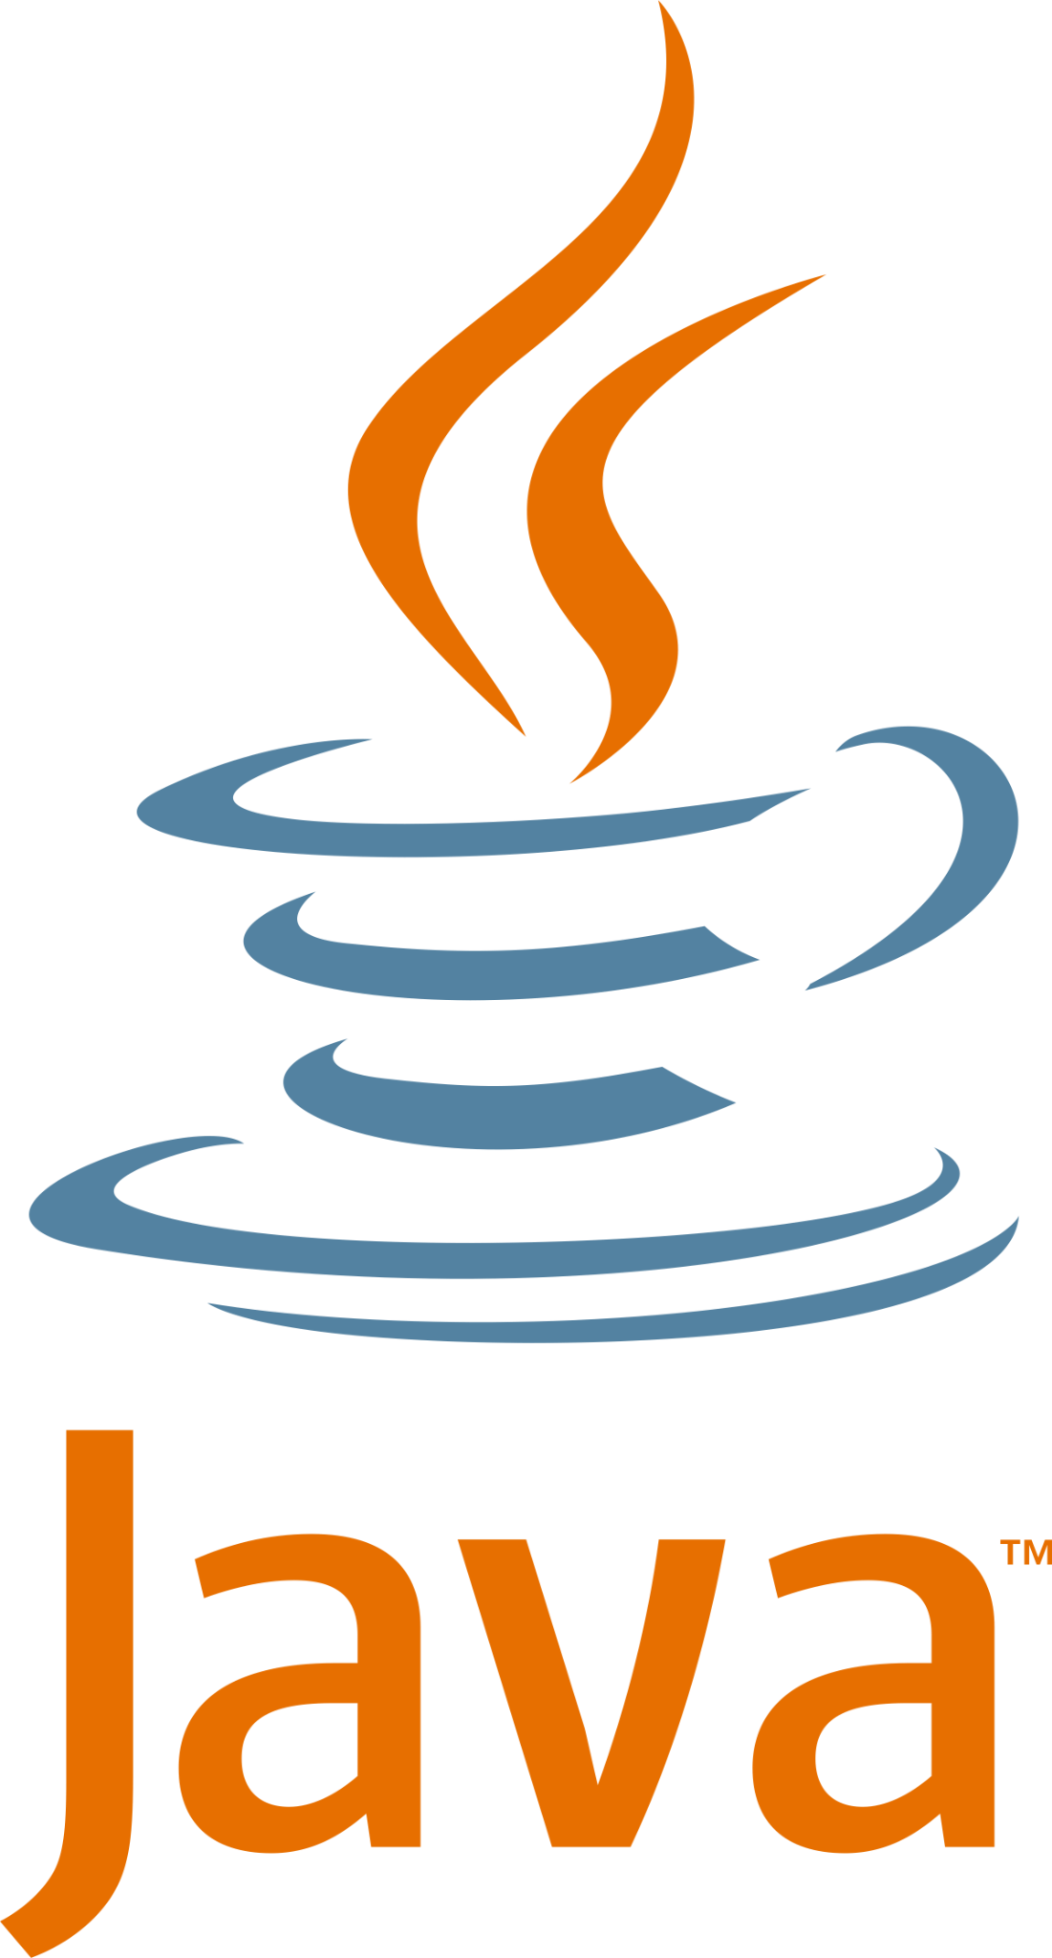
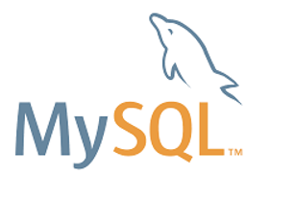

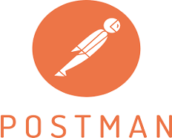

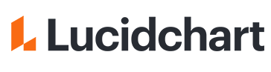
Tech Stack
Framework
Backend
Data
Tools
Core Language
SQL Database
Version Control
API Client
Application Server
Diagramming Application
Notes:
-RESTful web services are services that are built to work best on the web. Representational State Transfer (REST) is an architectural style.
-Jersey RESTful Web Services 2. x framework is open source, framework for developing RESTful Web Services in Java that provides support for JAX-RS APIs and serves as a JAX-RS.
-Dropwizard pulls together stable, mature libraries from the Java ecosystem into a simple, lightweight package that lets you focus on getting things done.
Dropwizard is an open-source Java framework used for the fast development of high-performance RESTful web services
Essentially it's an open-source Java servlet and Java Server Page container that lets developers implement an array of enterprise Java applications. Tomcat also runs a HTTP web server environment in which Java code can run
Postman is an interactive and automatic tool for verifying the APIs of your project. ... It works on the backend, and makes sure that each API is working as intended
-MySq:l MySQL is a relational database management system based on SQL – Structured Query Language. The application is used for a wide range of purposes, including data warehousing, e-commerce, and logging applications
-Lucidchart Create flowcharts & diagrams online. It heled us to visualize our ideas faster, clearer and more collaboratively.
-for version control we used git. Github is a web-based platform used for version control. Git simplifies the process of working with other people and makes it easy to collaborate on projects.

Slide 13
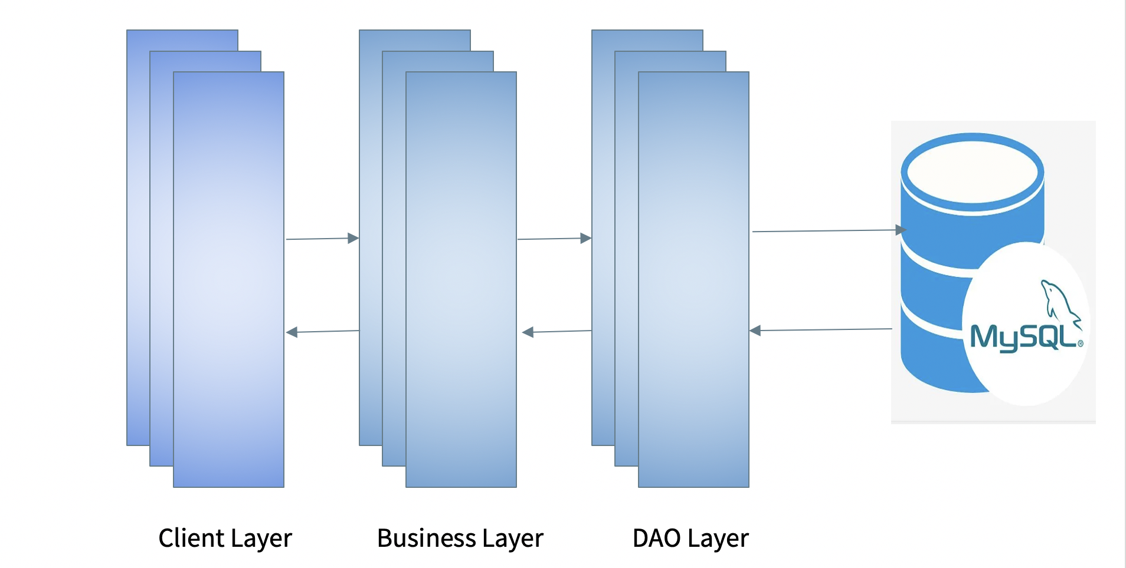

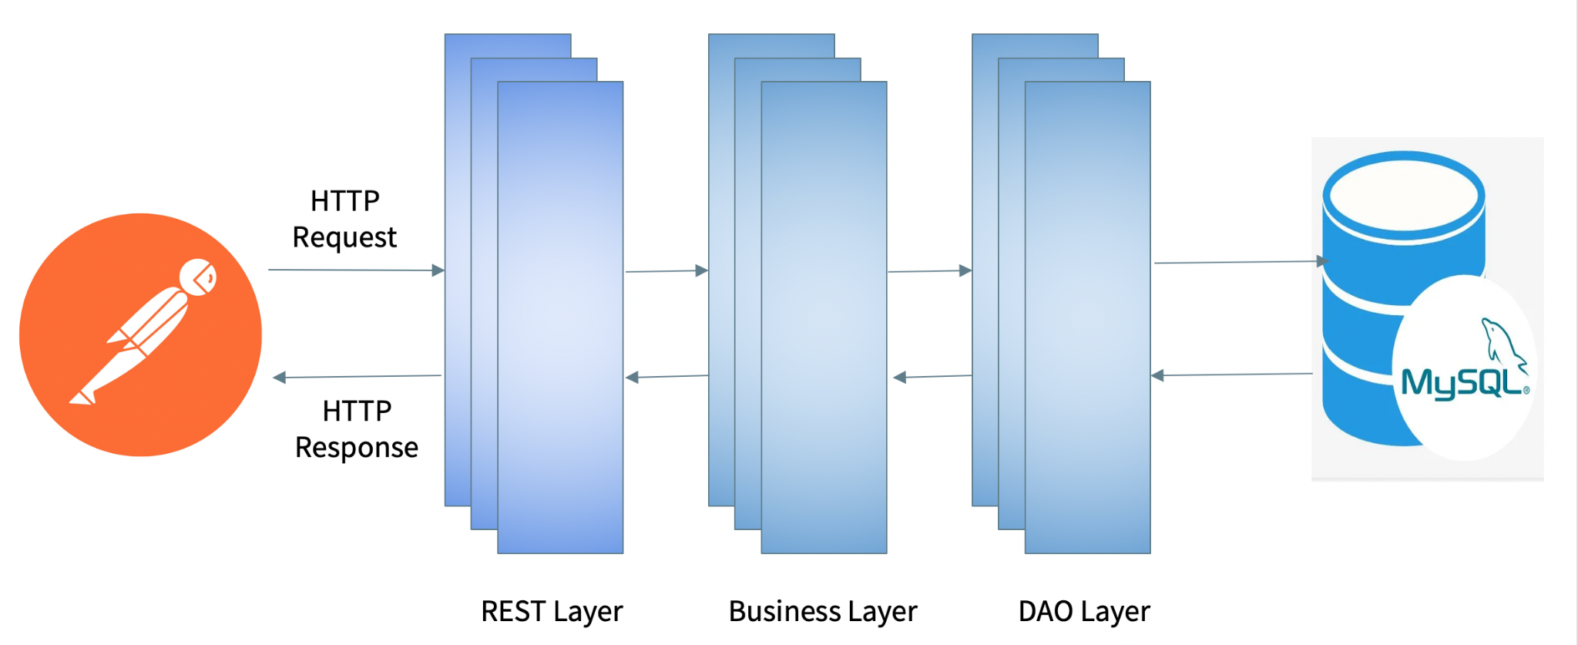
System Architecture: Console Application
Request
Response
User

Slide 14
System Architecture: REST API

Slide 15

Challenges
Setting up of environment
Analysing the scope of program
Refactoring code to make it accurate in terms of reusability or good code practices based on review
Resolving errors and working on code review
Conflicts while merging on git
Running the project across various tech stacks
Inter-OS Dependency
Database Schema and integration
Notes:
Hi! Who’s this?
Pravallika here
You? Nachiiii
Ishaan
We should say whoo took care of beautification.. In team intro part😂
Lol
Will see when everyone returns
FYI, we are in Google meet We can talk rather than type😂
😂😂😂

Slide 16

Learnings
Hands on “theory”
Learnt about “separation of concern”- how each class holds its own responsibility.
Model design should be done properly, can affect thought process of a model.
Design patterns should be followed
Hands on some completely new frameworks and APIs.
Should design database first, else cause refactoring of code.
Learnt about working in a team and collaborating with others virtually.

Slide 17
Demo for Course Registration System
End to end flow of the Project Created

Slide 18

Questions?
Notes:
No questions

Slide 19
Thank You!

